Slide 1
UNIT 1
Introduction DBMS Concepts & Architectures

Slide 2
Welcome
First Year of Master of Computer Application
Advanced DBMS (IT-24)
Mr. N. N. Pachpor
Assistant Professor
Dept. of Master of Computer Application
IIMS, CHINCHWAD
nishant.pachpor@iims.ac.in
Cell. +91 9421888425

Slide 3
Contents: Principle of Layering concept :-Introduction DBMS – Concepts & Architectures 1.1 Database and Need for DBMS, Characteristics of DBMS 1.2 Database 3-tier schema (ANSI/SPARC) and system architecture of DBMS 1.3 Views of data- Schemas and instances, Data Independence 1.4 Centralized, Client-Server system, Transaction servers, Data servers, Cloud based servers
Unit-I: Introduction DBMS – Concepts & Architectures
Unit Objectives and outcomes: On completion the students will be able to:
To understand core concepts of database management system and its types
Unit outcomes : On completion the students will be able to
Outcome Mapping:
PEOs: POs: COs: CO1 PSOs:
Books used
Introduction to database systems C.J. Date, Pearson.
Database System Concepts by Abraham Silberschatz, H. Korth, Sudarshan
Database Management System by Raghu Ramakrishnan / Johannes Gherke

Slide 4
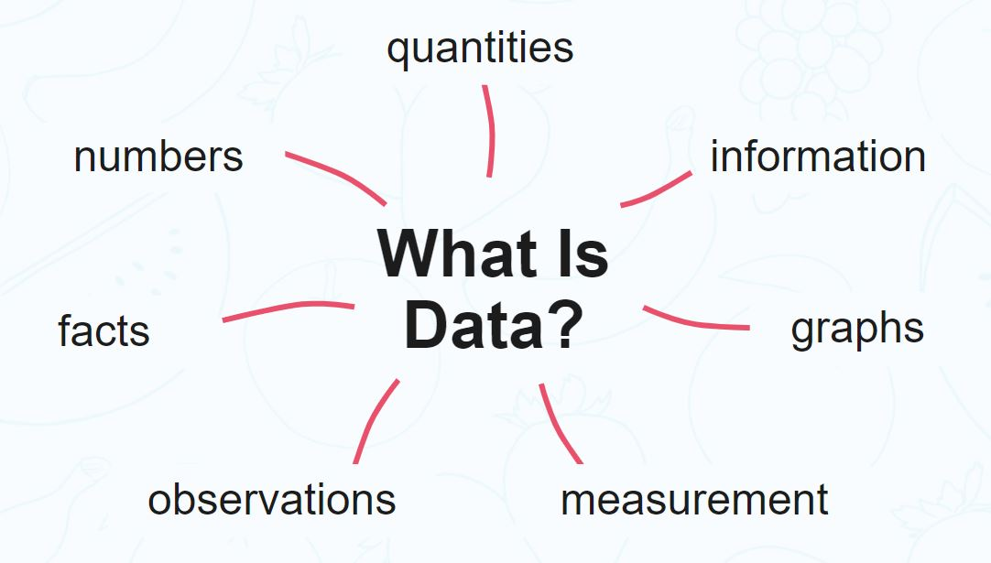
Introduction DBMS
What is Data?
Data is a collection of a distinct small unit of information. It can be used in a variety of forms like text, numbers, media, bytes, etc. it can be stored in pieces of paper or electronic memory, etc.
Word 'Data' is originated from the word 'datum' that means 'single piece of information.' It is plural of the word datum.
In computing, Data is information that can be translated into a form for efficient movement and processing. Data is interchangeable.

Slide 5
What is Database?
Database Management System or DBMS in short refers to the technology of storing and retrieving users data with utmost efficiency along with appropriate security measures.
A database is an organized collection of data, so that it can be easily accessed and managed.
You can organize data into tables, rows, columns, and index it to make it easier to find relevant information.
Database handlers create a database in such a way that only one set of software program provides access of data to all the users.

Slide 6

What is Database? (cont…)
The main purpose of the database is to operate a large amount of information by storing, retrieving, and managing data.
There are many dynamic websites on the World Wide Web nowadays which are handled through databases. For example, a model that checks the availability of rooms in a hotel. It is an example of a dynamic website that uses a database.
There are many databases available like MySQL, Sybase, Oracle, MongoDB, Informix, PostgreSQL, SQL Server, etc.
Modern databases are managed by the database management system (DBMS).
SQL or Structured Query Language is used to operate on the data stored in a database.
A cylindrical structure is used to display the image of a database.

Slide 7
Evolution of Databases
The database has completed more than 50 years of journey of its evolution from flat-file system to relational and objects relational systems. It has gone through several generations.
File-Based
1968 was the year when File-Based database were introduced. In file-based databases, data was maintained in a flat file. Though files have many advantages, there are several limitations.
One of the major advantages is that the file system has various access methods, e.g., sequential, indexed, and random.
It requires extensive programming in a third-generation language such as COBOL, BASIC.

Slide 8
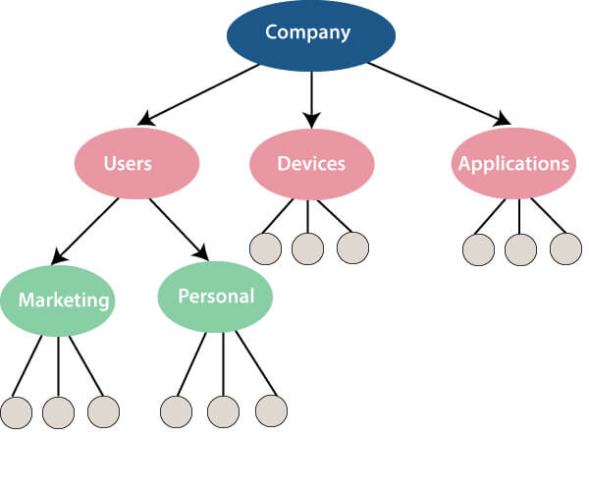
Evolution of Databases (cont…)
Hierarchical Data Model
1968-1980 was the era of the Hierarchical Database. Prominent hierarchical database model was IBM's first DBMS. It was called IMS (Information Management System).
In this model, files are related in a parent/child manner.
Below diagram represents Hierarchical Data Model.
Small circle represents objects.

Slide 9
Evolution of Databases (cont…)
Network data model
Charles Bachman developed the first DBMS at Honeywell called Integrated Data Store (IDS). It was developed in the early 1960s, but it was standardized in 1971 by the CODASYL group (Conference on Data Systems Languages).
In this model, files are related as owners and members, like to the common network model.
Network data model identified the following components:
Network schema (Database organization)
Sub-schema (views of database per user)
Data management language (procedural)

Slide 10
Evolution of Databases (cont…)
Relational Database
1970 - Present: It is the era of Relational Database and Database Management. In 1970, the relational model was proposed by E.F. Codd.
Relational database model has two main terminologies called instance and schema.
The instance is a table with rows or columns
Schema specifies the structure like name of the relation, type of each column and name.
The first internet database application had been created in 1995.
During the era of the relational database, many more models had introduced like object-oriented model, object-relational model, etc.

Slide 11
Evolution of Databases (cont…)
Cloud database
Cloud database facilitates you to store, manage, and retrieve their structured, unstructured data via a cloud platform. This data is accessible over the Internet. Cloud databases are also called a database as service (DBaaS) because they are offered as a managed service.
Some best cloud options are:
AWS (Amazon Web Services)
Snowflake Computing
Oracle Database Cloud Services
Microsoft SQL server
Google cloud spanner

Slide 12
Evolution of Databases (cont…)
NoSQL Database
A NoSQL database is an approach to design such databases that can accommodate a wide variety of data models. NoSQL stands for "not only SQL." It is an alternative to traditional relational databases in which data is placed in tables, and data schema is perfectly designed before the database is built.
NoSQL databases are useful for a large set of distributed data.
Some examples of NoSQL database system with their category are:
MongoDB, CouchDB, Cloudant (Document-based)
Memcached, Redis, Coherence (key-value store)
HBase, Big Table, Accumulo (Tabular)

Slide 13
Need for DBMS
DBMS is useful in the following ways:
Ease of Accessing Data
Storage and Management of Data
Easy and Efficient File Management
Avoiding duplicates and Redundancy
Concurrent Data Accessing
Database Integrity

Slide 14
Need for DBMS (cont…)
Ease of Accessing Data
In the file system, different files are created for each user containing which data they can access. Also, in the file system, for the user to extract data, there is a need for code or application.
DBMS removes redundancy by granting access to users and decides which and how many parts of data is accessible to them from the database. Users can get easy access to data and can also specify the type of data they want to extract. In DBMS, users through queries can get easy access to data.

Slide 15
Need for DBMS (cont…)
Storage and Management of Data
Data cannot be stored in the form of objects in the file system.
The data in the practical world is generally stored in the form of objects and not files.
In DBMS, the data can be directly stored in the form of objects. In DBMS, user can query the database whereas in file system level code is written for handling, saving, and scanning of data.

Slide 16
Need for DBMS (cont…)
Easy and Efficient File Management
In the file system, the entire database runs for every query operation as files are indexed. It takes a lot of time compared to DBMS, where objects are indexed based on the attribute of data. The complex management of memory becomes easy to handle. With this, retrieval of data is faster than the traditional file system.

Slide 17
Need for DBMS (cont…)
Avoiding duplicates and Redundancy
Redundancy means repetition of the same data. In the file system, the storage of data might take place multiple times. Like, if a student is pursuing two courses in the same institution say English and Science, then his general information might get stored in both the English dept as well as Science dept. It results in prolonged hours of accessing and storing data. It further results in the inconsistency of data in both departments. Data normalization is used in DBMS to avoid duplicate data.

Slide 18
Characteristics of DBMS
Real World Entity
Self-Describing Nature
Support ACID Properties
Concurrent Use of Database
Insulation Between Data and Program
Transactions
Data Persistence
Backup and Recovery
Data Integrity
Multiple Views
Stores Any Kind of Data
Security
Cost

Slide 19
Characteristics of DBMS(cont…)
Real World Entity
DBMS real-world entities are used to design its architecture. Also, behavior and attributes are used by DBMS.
2. Self-Describing Nature

Slide 20
Function of DBMS
Data Security & data Integrity
Data Definition : - Define the Structure of DBMS
Data Manipulation :- It Contains Manipulation of data i.e. Inserting, modifying, and deleting function.
Data Recovery :- After system failure to recover data in the database.
Concurrency :- Handle concurrent access of multiple user

Slide 21
Database Languages
Read, Update, Manipulate, and Store data in a database using Database Languages. The following are the database languages −
Data Definition Language
Data Manipulation Language
Data Control Language
Transaction Control Language

Slide 22
Database Languages (cont…)
Data Definition Language
The language is used to create database, tables, alter them, etc. With this, you can also rename the database, or drop them. It specifies the database schema.
The DDL statements include −
CREATE: Create new database, table, etc.
ALTER: Alter existing database, table, etc.
DROP: Drop the database
RENAME: Set a new name for the table.

Slide 23
Database Languages (cont…)
Data Manipulation Language
The language used to manipulate the database like inserting data, updating table, retrieving record from a table, etc. is known as Data Manipulation Language −
SELECT: Retrieve data from the database
INSERT: Insert data
UPDATE: Update data
DELETE: Delete all records

Slide 24
Database Languages (cont…)
Data Control Language
Grant privilege to a user using the GRANT statement. In the same way, revoke the privilege using the REVOKE statement. Both of these statements come under the Data Control Language (DCL). −
GRANT: Give privilege to access the database.
REVOKE: Take back the privilege to access the database.

Slide 25
Database Languages (cont…)
Transaction Control Language
Manage transactions in the Database using the Transaction Control Language −
COMMIT: Save the work.
SAVEPOINT: Set a point in transaction to rollback later
ROLLBACK: Restores since last commit

Slide 26
Database 3-tier schema (ANSI/SPARC) and system architecture of DBMS
ANSI SPARC THREE-TIER architecture has main three levels:
Internal Level
Conceptual Level
External Level
These three levels provide
data abstraction ;means hide the low level complexities from end users
A database system should be efficient in performance and convenient in use.
Using these three levels, it is possible to use complex structures at internal level for efficient operations and to provide simpler convenient interface at external level.

Slide 27
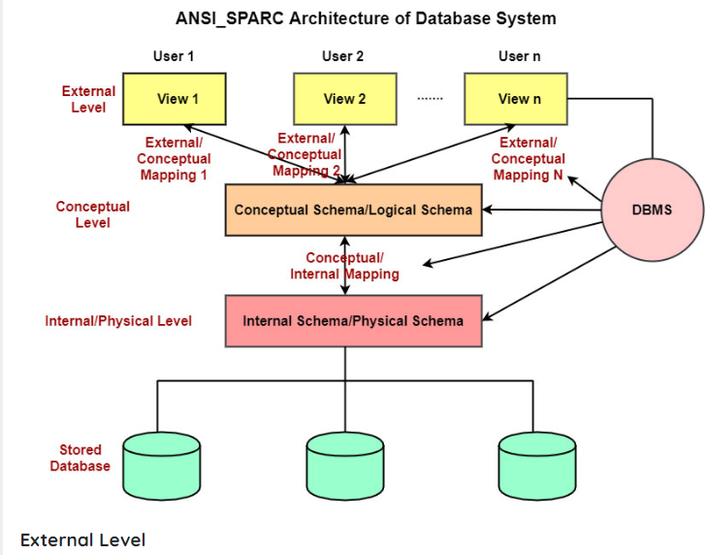
Database 3-tier schema (ANSI/SPARC) and system architecture of DBMS

Slide 28
Database 3-tier schema (ANSI/SPARC) and system architecture of DBMS
1. Internal level:
This is the lowest level of data abstraction.
It describes How the data are actually stored on storage devices.
It is also known as physical level.
It provides internal view of physical storage of data.
It deals with complex low level data structures, file structures and access methods in detail.
It also deals with Data Compression and Encryption techniques, if used.

Slide 29
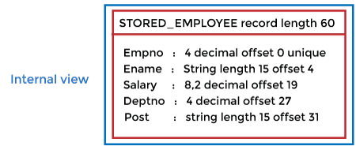
Database 3-tier schema (ANSI/SPARC) and system architecture of DBMS

Slide 30
Database 3-tier schema (ANSI/SPARC) and system architecture of DBMS
Conceptual level:
This is the next higher level than internal level of data abstraction.
It describes What data are stored in the database and What relationships exist among those data.
It is also known as Logical level.
It hides low level complexities of physical storage.
Database administrator and designers work at this level to determine What data to keep in database.
Application developers also work on this level.

Slide 31
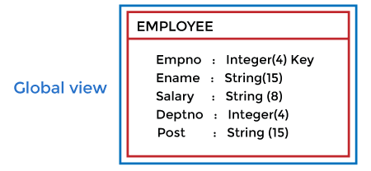
Database 3-tier schema (ANSI/SPARC) and system architecture of DBMS

Slide 32
Database 3-tier schema (ANSI/SPARC) and system architecture of DBMS
External Level:
This is the highest level of data abstraction.
It describes only part of the entire database that a end user concern.
It is also known as an view level.
End users need to access only part of the database rather than entire database.
Different user need different views of database. And so,there can be many view level abstractions of the same database.

Slide 33
Database 3-tier schema (ANSI/SPARC) and system architecture of DBMS

Slide 34
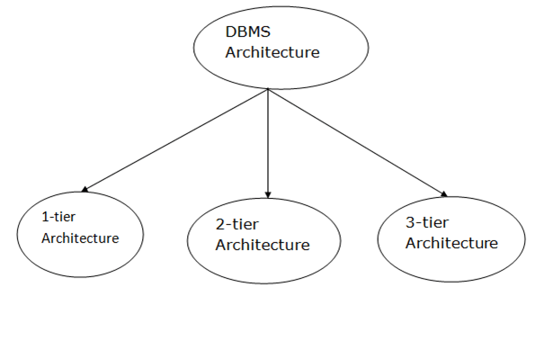
Types of DBMS Architecture

Slide 35
1-Tier Architecture
In this architecture, the database is directly available to the user. It means the user can directly sit on the DBMS and uses it.
Any changes done here will directly be done on the database itself. It doesn't provide a handy tool for end users.
The 1-Tier architecture is used for development of the local application, where programmers can directly communicate with the database for the quick response.

Slide 36
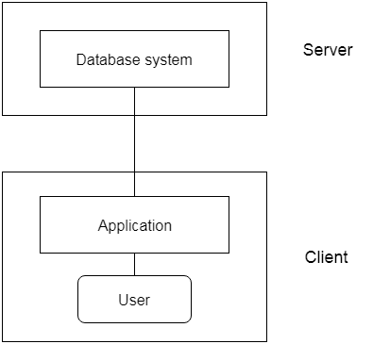
2-Tier Architecture
Fig: 2-tier Architecture

Slide 37
3-Tier Architecture
The 3-Tier architecture contains another layer between the client and server. In this architecture, client can't directly communicate with the server.
The application on the client-end interacts with an application server which further communicates with the database system.
End user has no idea about the existence of the database beyond the application server. The database also has no idea about any other user beyond the application.
The 3-Tier architecture is used in case of large web application.

Slide 38
2-Tier Architecture
The 2-Tier architecture is same as basic client-server. In the two-tier architecture, applications on the client end can directly communicate with the database at the server side. For this interaction, API's like: ODBC, JDBC are used.
The user interfaces and application programs are run on the client-side.
The server side is responsible to provide the functionalities like: query processing and transaction management.
To communicate with the DBMS, client-side application establishes a connection with the server side.

Slide 39
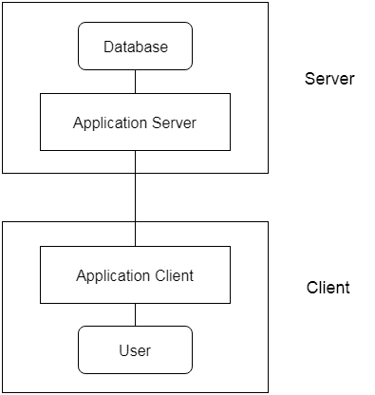
3-Tier Architecture
Fig: 3-tier Architecture

Slide 40
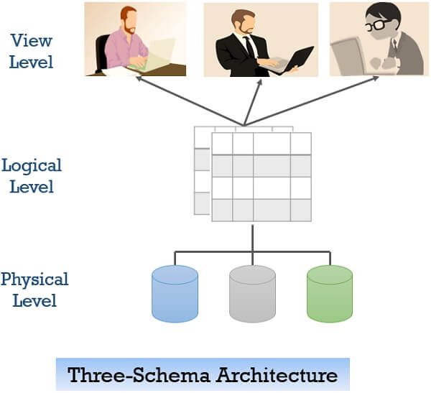
View of Data in DBMS

Slide 41
View of Data in DBMS
Abstraction is one of the main features of database systems. Hiding irrelevant details from user and providing abstract view of data to users, helps in easy and efficient user-database interaction.
Three level of DBMS architecture, The top level of that architecture is “view level”. The view level provides the “view of data” to the users and hides the irrelevant details such as data relationship, database schema, constraints, security etc from the user.

Slide 42
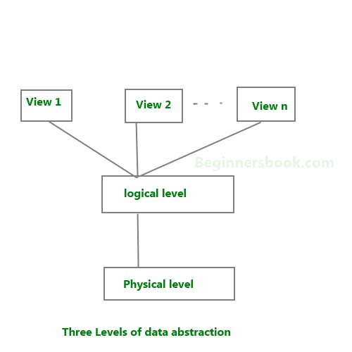
Data Abstraction in DBMS
Database systems are made-up of complex data structures. To ease the user interaction with database, the developers hide internal irrelevant details from users. This process of hiding irrelevant details from user is called data abstraction.

Slide 43
Data Abstraction in DBMS (Cont..)
We have three levels of abstraction:
Physical level: This is the lowest level of data abstraction. It describes how data is actually stored in database. You can get the complex data structure details at this level.
Logical level: This is the middle level of 3-level data abstraction architecture. It describes what data is stored in database.
View level: Highest level of data abstraction. This level describes the user interaction with database system.

Slide 44
Data Abstraction in DBMS (Cont..)
Example: Let’s say we are storing customer information in a customer table. At physical level these records can be described as blocks of storage (bytes, gigabytes, terabytes etc.) in memory. These details are often hidden from the programmers.
At the logical level these records can be described as fields and attributes along with their data types, their relationship among each other can be logically implemented. The programmers generally work at this level because they are aware of such things about database systems.

Slide 45
Data Abstraction in DBMS (Cont..)
At view level, user just interact with system with the help of GUI and enter the details at the screen, they are not aware of how the data is stored and what data is stored; such details are hidden from them.

Slide 46
Instance and schema in DBMS
Definition of schema: Design of a database is called the schema. Schema is of three types: Physical schema, logical schema and view schema
For example: In the following diagram, we have a schema that shows the relationship between three tables: Course, Student and Section. The diagram only shows the design of the database, it doesn’t show the data present in those tables. Schema is only a structural view(design) of a database as shown in the diagram below.

Slide 47
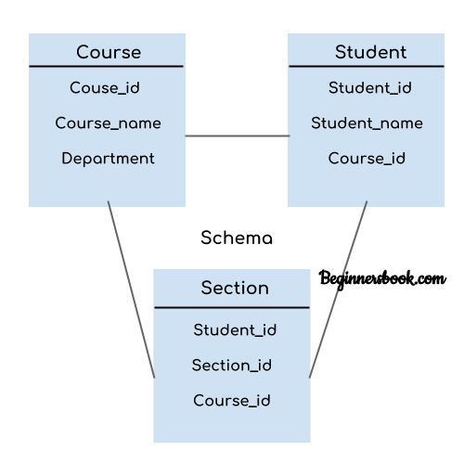
Instance and schema in DBMS(cont…)
The design of a database at physical level is called physical schema, how the data stored in blocks of storage is described at this level

Slide 48
Instance and schema in DBMS(cont…)
Design of database at logical level is called logical schema, programmers and database administrators work at this level, at this level data can be described as certain types of data records gets stored in data structures, however the internal details such as implementation of data structure is hidden at this level (available at physical level).
Design of database at view level is called view schema. This generally describes end user interaction with database systems.

Slide 49
DBMS Instance
Definition of instance: The data stored in database at a particular moment of time is called instance of database. Database schema defines the variable declarations in tables that belong to a particular database; the value of these variables at a moment of time is called the instance of that database.

Slide 50
DBMS Instance(cont…)
For example, lets say we have a single table student in the database, today the table has 100 records, so today the instance of the database has 100 records.
Lets say we are going to add another 100 records in this table by tomorrow so the instance of database tomorrow will have 200 records in table. In short, at a particular moment the data stored in database is called the instance, that changes over time when we add or delete data from the database.

Slide 51
Data Independence
Data independence defines the extent to which the data schema can be changed at one level without modifying the data schema at the next level. Data independence can be classified as shown below:
Logical Data Independence
Physical Data Independence

Slide 52
Data Independence
Logical Data Independence:
Logical data independence describes the degree up to which the logical or conceptual schema can be changed without modifying the external schema.
the changes to data schema at the logical level are made either to enlarge or reduce the database by adding or deleting more entities, entity sets, or changing the constraints on data.

Slide 53
Data Independence (cont…)
Physical Data Independence:
Physical data independence defines the extent up to which the data schema can be changed at the physical or internal level without modifying the data schema at logical and view level.
the physical schema is changed if we add additional storage to the system or we reorganize some files to enhance the retrieval speed of the records.

Slide 54
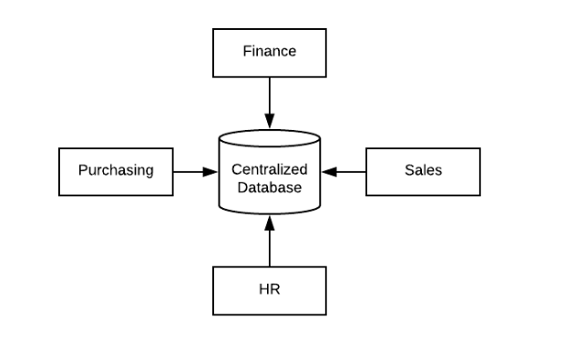
Centralized DBMSs Architecture
A centralized database is stored at a single location such as a mainframe computer. It is maintained and modified from that location only and usually accessed using an internet connection such as a LAN or WAN. The centralized database is used by organizations such as colleges, companies, banks etc.

Slide 55
Centralized DBMSs Architecture (cont…)
All the information for the organisation is stored in a single database. This database is known as the centralized database.
Advantages
The data integrity is maximised as the whole database is stored at a single physical location. This means that it is easier to coordinate the data and it is as accurate and consistent as possible.
The data redundancy is minimal in the centralised database. All the data is stored together and not scattered across different locations. So, it is easier to make sure there is no redundant data available.

Slide 56
Centralized DBMSs Architecture (cont…)
Advantages
All the data is in one place, there can be stronger security measures around it. So, the centralised database is much more secure.
Data is easily portable because it is stored at the same place.
The centralized database is cheaper than other types of databases as it requires less power and maintenance.
All the information in the centralized database can be easily accessed from the same location and at the same time.

Slide 57
Centralized DBMSs Architecture (cont…)
Dis- Advantages
Since all the data is at one location, it takes more time to search and access it. If the network is slow, this process takes even more time.
There is a lot of data access traffic for the centralized database. This may create a bottleneck situation.
Since all the data is at the same location, if multiple users try to access it simultaneously it creates a problem. This may reduce the efficiency of the system.
If there are no database recovery measures in place and a system failure occurs, then all the data in the database will be destroyed.

Slide 58
Client-Server Architecture
Client-server architecture is a network model where every process or computer on a network is a server or a client.
The client-servers are the robust computers that are dedicated to managing the printers, disk drives, and network traffic.
Clients are workstations or PCs on which the users run their applications. Clients mainly rely on the servers for resources, like devices, files, and processing power.

Slide 59
Client-Server Architecture (cont..)
What is Client-Server Architecture?
A client-server architecture or model is an application network separating tasks between the clients and servers that live in the same system or have to communicate through a computer network.
The server-client mainly relies on sending the request to another program to access the service made accessible by the server. Server runs a few programs that share the resources with & distribute work among the clients.

Slide 60

Client-Server Architecture (cont..)

Slide 61
Client-Server Architecture (cont..)
Client: The word Client means an organization or an individual using a service. Even in the digital world Client is a Host (computer) that can receive information or using service from the Servers.
Server: Server means a person that serves something. The server, in the digital world, is the remote computer that offers information or access to services.

Slide 62
Client-Server Architecture (cont..)
Types of Client-Server Architecture
1-Tier Architecture
All client or server configuration settings, UI environment, data logic, as well as marketing logic are there on the same system.
The 1-tier architecture services are quite reliable but tough tasks to handle as they have all data in various variance that will be allotted the complete replication of the whole work. 1-Tier architecture also has different layers.

Slide 63
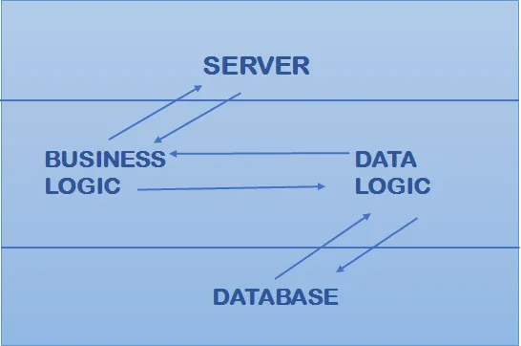
Client-Server Architecture (cont..)
For example –Business, Presentation, Data Access layer using a single software package. Data will be saved on a local machine. Some applications manage 3 tiers like an MP3 player and MS Office; however, these applications are presented in a 1-tier architecture system.

Slide 64
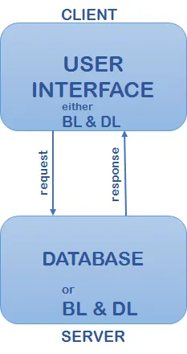
Client-Server Architecture (cont..)
2-Tier Architecture In 2-Tier Architecture, the UI is stored at the client machine, and the database gets stored on a server.
The business logic and database logic are filed at server or client but have to be well-maintained. Suppose Data Logic and Business Logic are collected at the client-side, it’s called fat client-server architecture. Suppose Data Logic and Business Logic are handled on a server, its thin client-server architecture.

Slide 65
Client-Server Architecture (cont..)
2-Tier Architecture
In 2-Tier architecture, server and client need to come in the direct incorporation. Suppose a client provides any input to a server there must not be any intermediate. It is generally done for rapid results and to avoid confusion between various clients. For example, an online ticket reservations application uses this 2-Tier architecture.

Slide 66
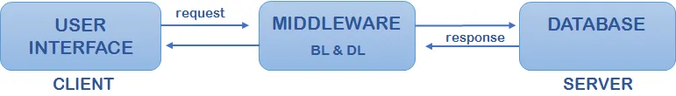
Client-Server Architecture (cont..)
3-Tier Architecture
It consists of the presentation tier that is the User Interface layer, an application tier that is a service layer, which performs the detailed processing, and a data tier that consists of the database server, which stores information.

Slide 67
Client-Server Architecture (cont..)
3-Tier Architecture
Three-tier architecture can be split into 3 parts, the presentation layer (or Client Tier), the Application layer (or Business Tier), and the Database layer (or Data Tier). It works in the following ways: The Client system handles the Presentation layer; the Application server looks after the Application layer, and the Server system supervises the Database layer.

Slide 68
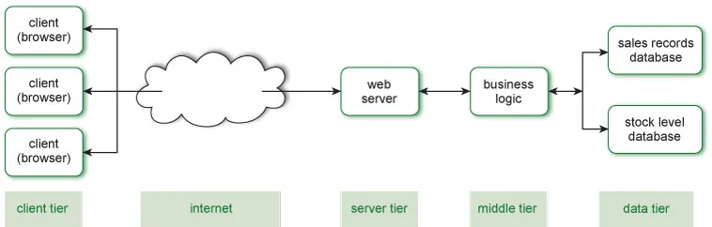
Client-Server Architecture (cont..)
N-Tier Architecture

Slide 69
Advantages of Client-Server Architecture
Cost-efficient needs less maintenance cost & Data recovery is made possible.
The capacity of the Client/Servers will be changed separately.
Centralized system with data in one single place.

Slide 70
Disadvantages of Client-Server Architecture
Clients can be prone to viruses, worms, and Trojans if present in a Server/uploaded in the Server.
The server can be prone to Denial of Service attacks.
Data packets will be modified or spoofed during the transmission.
Phishing and capturing login credentials and other useful info of user are quite common and Man in a Middle attack will be common.

Slide 71
Examples of Client-Server Architecture
Mail Servers: Email servers can be used for sending & receiving emails. Different software allows email handling.
File Servers: They are the centralized location for the files. For example, cloud services for Microsoft Office and Google docs will be accessed from your devices, and files that you save from the computer will be accessed from your phone. In this way, file stores will be centralized and accessed by multiple clients.
Web Servers: These servers will host different websites and these are high-performance computers where websites get hosted. The client is using, and the web server is a server system, which hosts these websites. The user or client requests resources or server’s site data through high-speed internet.

Slide 72
Data servers
A data server (DS) is a software program/platform used to provide database services like storing, processing and securing data.
A data server is also known as a database server.
A data server contains the installation of the database system. The hardware configuration of a data server varies for different databases. The database management system (DBMS) is accessed by other software or by front-end tools like SQL+ or Toad (for Oracle).

Slide 73
Data servers
The primary function of a data server is to store data and provide access to the other systems. The basic access mechanism is to use query languages like SQL. The basic structures of query languages are similar with some variations depending upon the data system. A data system takes queries as input and converts it into a form understandable by the database, and then executes it to produce the desired output. Some of the widely used database servers include Oracle, SQL Server and DB2.

Slide 74
What is a cloud server?
A cloud server is powerful physical or virtual infrastructure that performs application- and information-processing storage. Cloud servers are created using virtualization software to divide a physical (bare metal) server into multiple virtual servers. Organizations use an infrastructure-as-a-service (IaaS) model to process workloads and store information. They can access virtual server functions remotely through an online interface.

Slide 75
Questions
Enlist various Application of DBMS
Define data Schema and instance

